Slide 1
Observations and implications of artificial vegetation on suspended sediment capture in laboratory flume experiments
Justin Nghiem
2018-19 Undergraduate Honors Thesis
Department of Geography, UC Berkeley
Advisor: Laurel Larsen

Slide 2
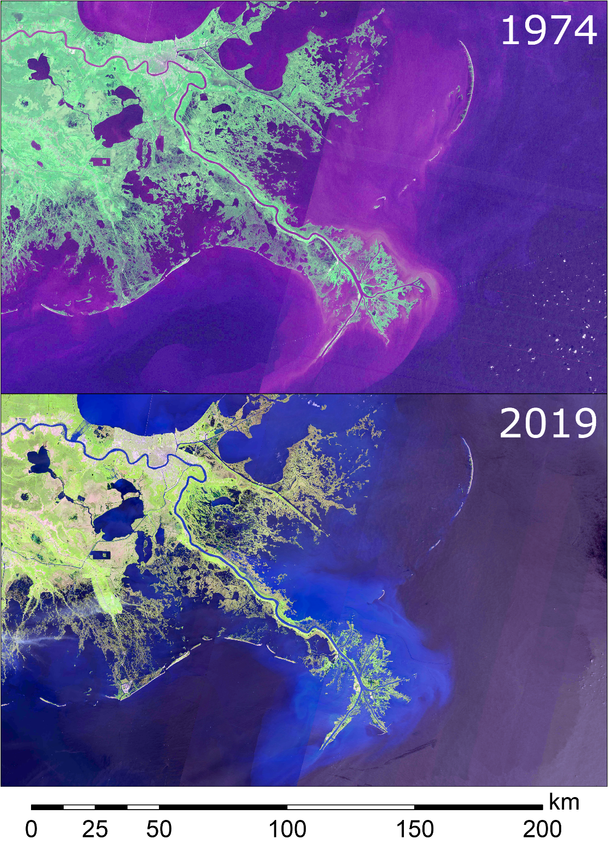
Motivation
Coastal wetlands are facing historically rapid land loss
Mississippi River Delta has lost over 5000 km² of wetlands since 1930s
Relative sea level rise accelerates loss

Slide 3
Motivation
Strategy: vegetation enhances retention of transported sediment load
Based on previous studies [Palmer et al., 2004; Wu et al., 2011; Fauria et al., 2015]
Mathematical models to predict particle capture are valuable tools for wetland management
Empirical models of Palmer et al. [2004] and Fauria et al. [2015]

Slide 4
Research Questions
How well do existing models of suspended particle capture by vegetation stems perform?
Are there important but unaccounted parameters?
Through flume experiments, what is the influence of vegetation on suspended particle capture in wetlands?

Slide 5
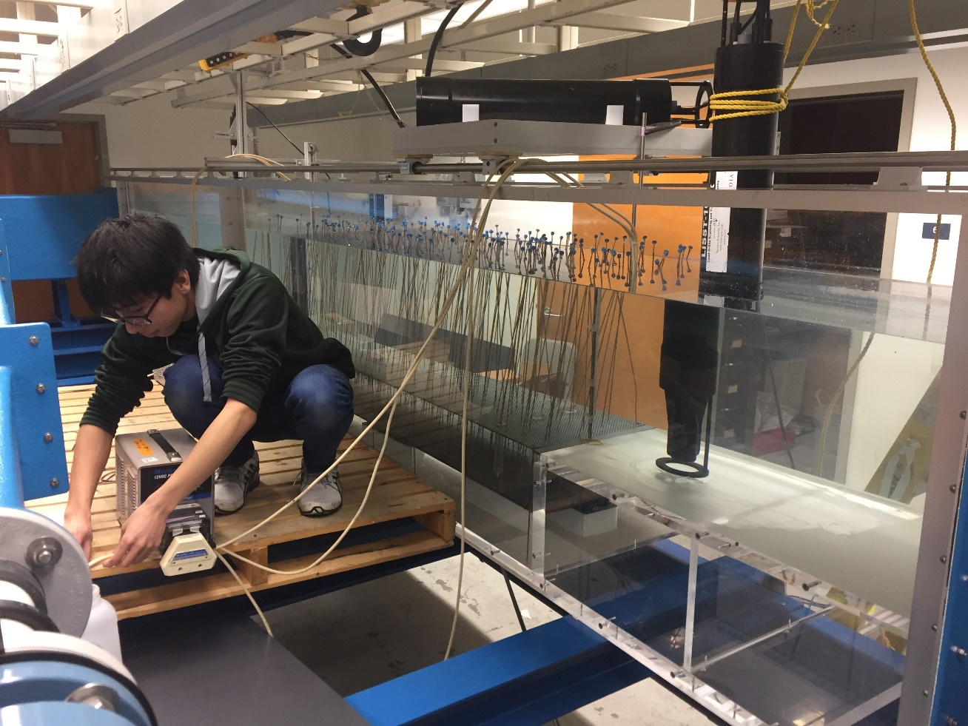
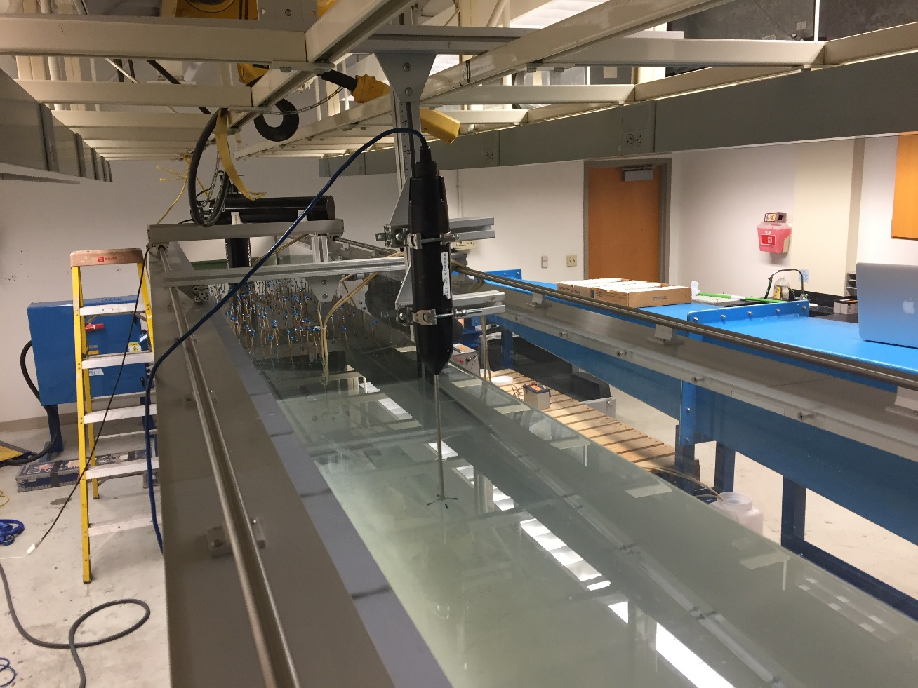
One method: Flume experiments

Slide 6
General Terms
Particle capture – general removal of sediment particles from transport in the flow
Collectors – vegetation stems (or stem-like objects) in the flow; their surfaces “collect” particles from the flow
Suspended load – sediment transported in a flow in suspension

Slide 7
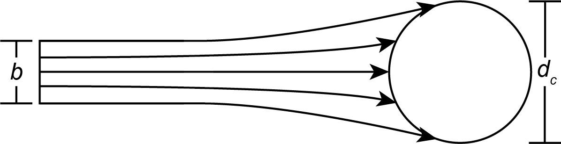
Particle capture mechanisms
Gravitational settling
Direct interception
Diffusional deposition – turbulence, Brownian motion
Inertial impaction – divergence from flowlines

Slide 8
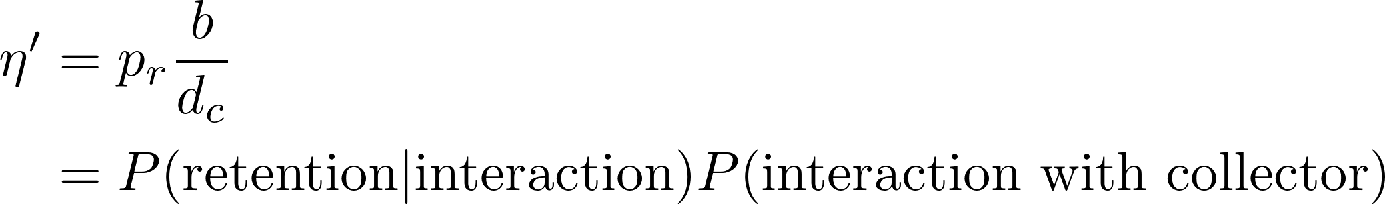
Effective capture efficiency
Quantifies overall rate of particle capture by collectors

Slide 9
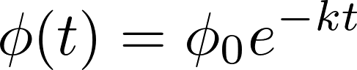
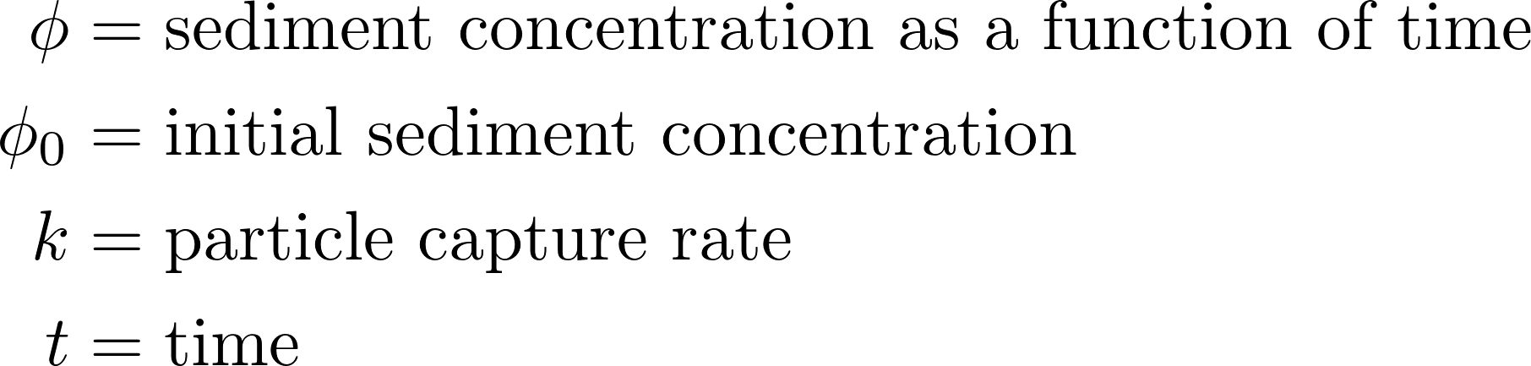
Suspended load model
In practice, fit an exponential model, a solution of an advection-diffusion equation [Fauria et al., 2015]
where

Slide 10
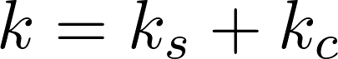
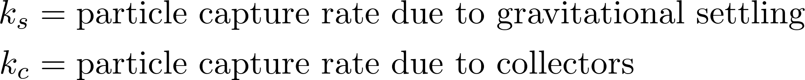
Particle capture rate
Particle capture rate k quantifies how fast sediment concentration declines with time
May be decomposed as
Key: separate effects of settling and collectors
where

Slide 11
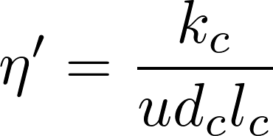
Parameter Estimation Summary
1. Suspended load model
Estimate k using data
Partition k into contributions of settling and capture on collectors
Estimate effective capture efficiency using k_{c}
2. Decomposition
3. Estimated effective capture efficiency

Slide 12
Methods
Flume experiments (~100 min)
Two experiments: with dowels, without dowels
Model vegetation stems using array of wooden dowels
Sediment added to flume at start of experiment
Instruments:
Peristaltic pumps
Acoustic Doppler velocimeter (ADV)
Sediment traps

Slide 13
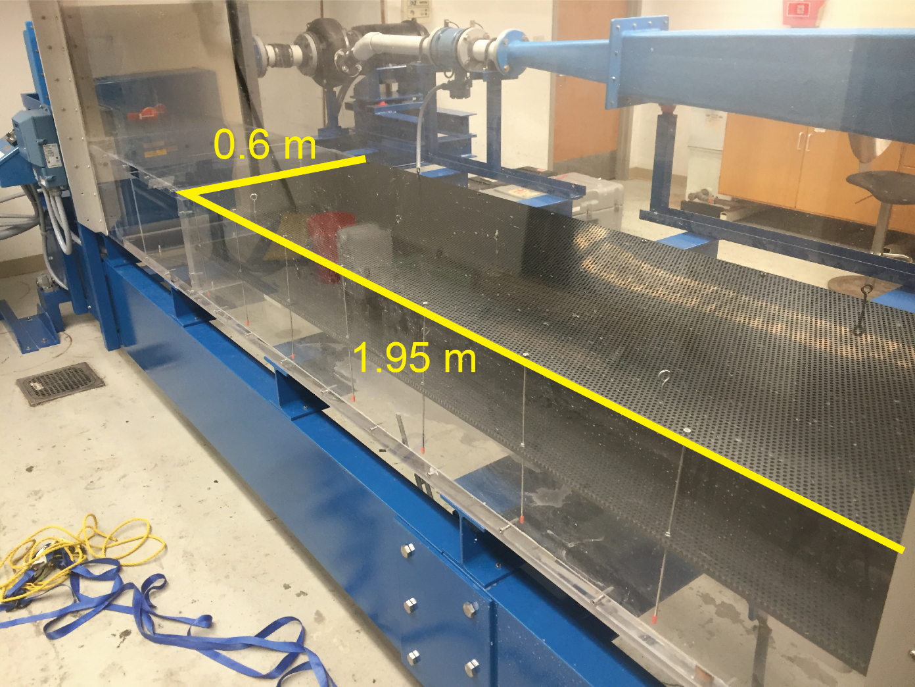
Recirculating Flume
average flow velocity 5-6 cm/s
Transitional flow
5.25 m long x 0.6 m wide channel
0.4 m water depth
False bed converted into “test section” for dowels

Slide 14
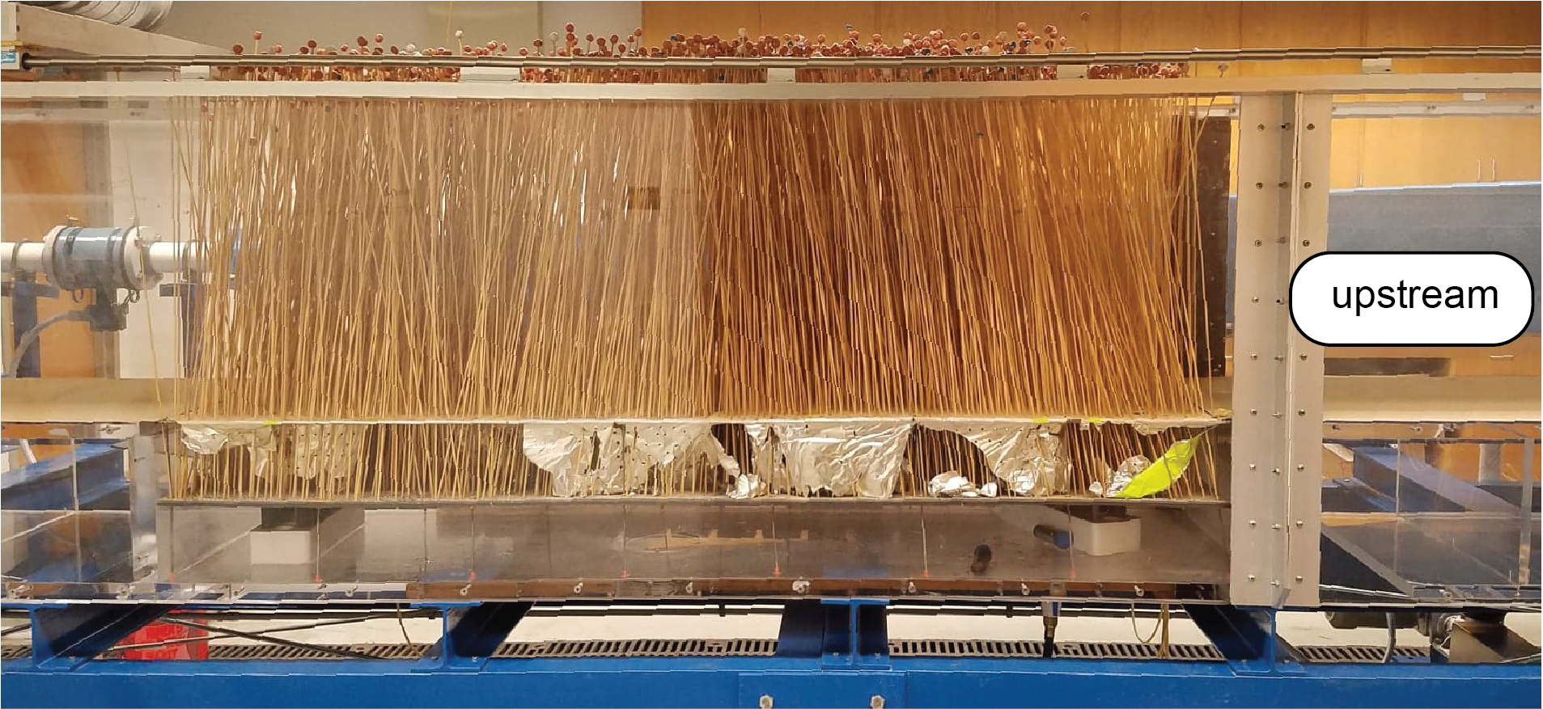
Dowels
Coat with silicone grease as biofilm analogue
Install in test section in roughly uniform pattern
Approximate dowel density in the test section of 1450 dowels/m² in dowel treatment

Slide 15
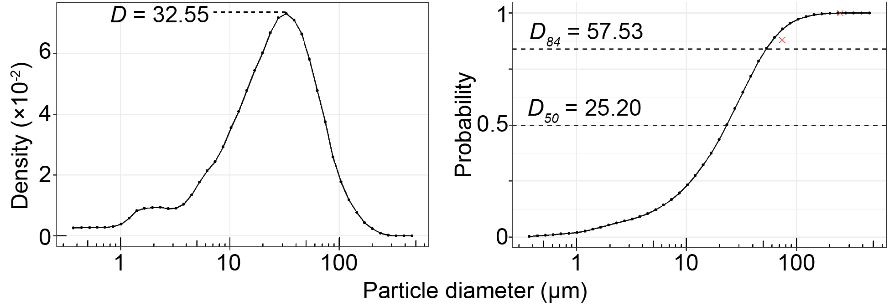
Sediment
Crushed walnut shell (~silt)
200 g added at start of each experiment

Slide 16
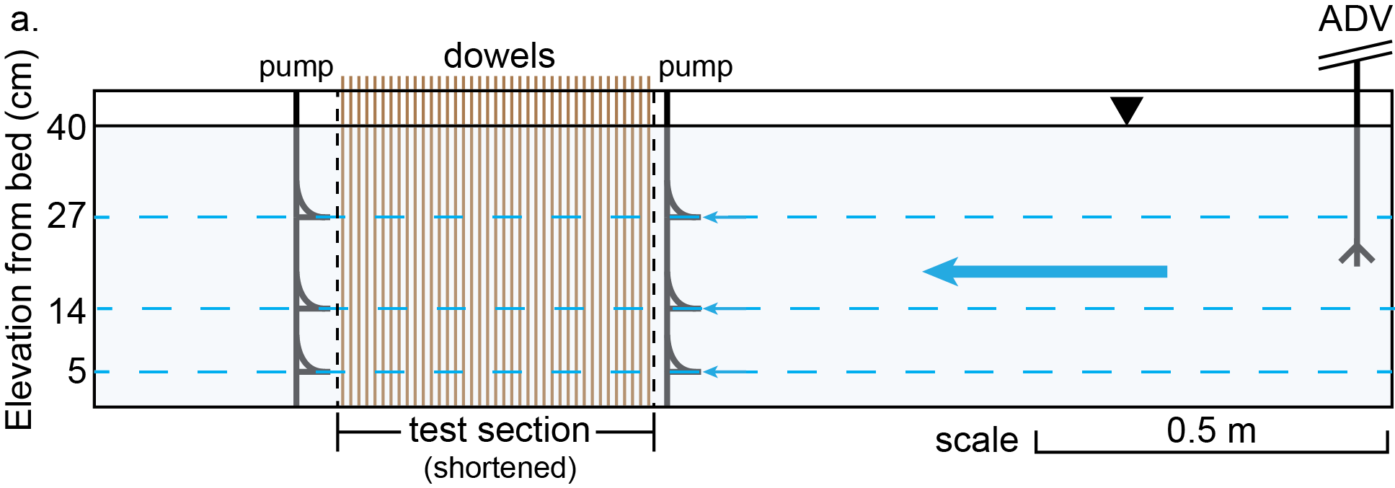
Instruments
Peristaltic pumps: sample water at 5-min intervals
ADV: measure flow velocity during experiments

Slide 17
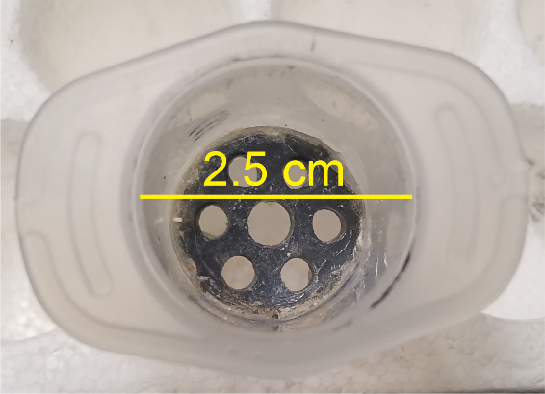
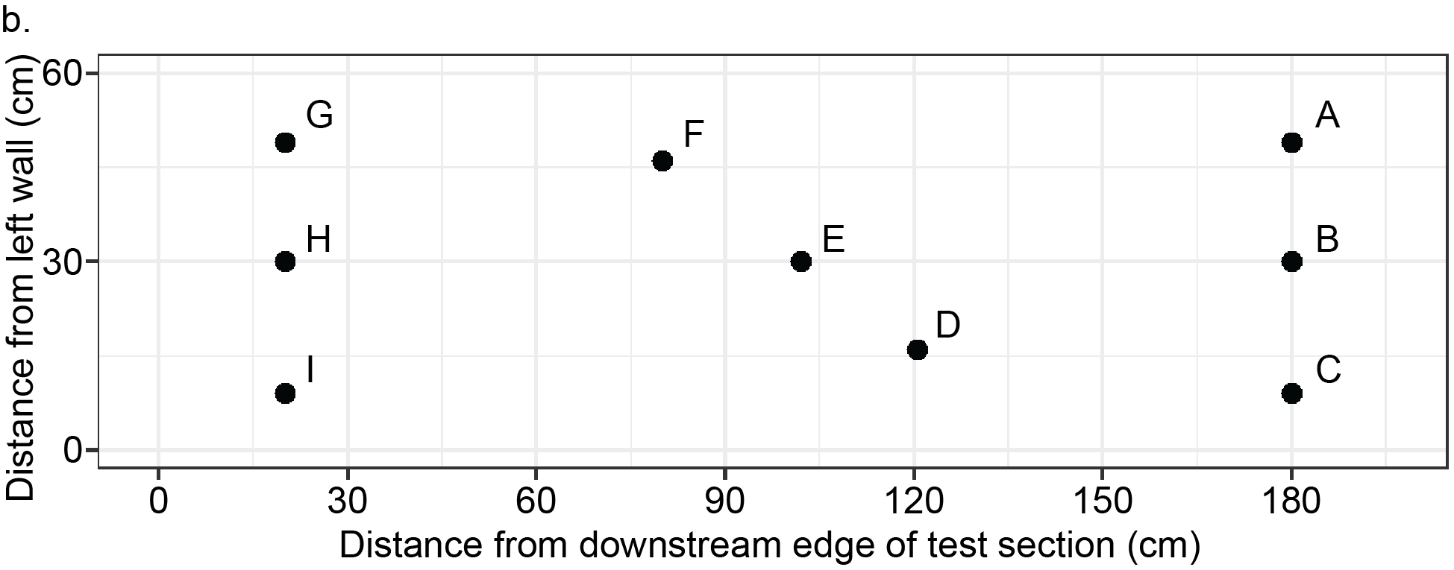
Instruments
Sediment traps: accumulate settled particles in locations in the test section

Slide 18
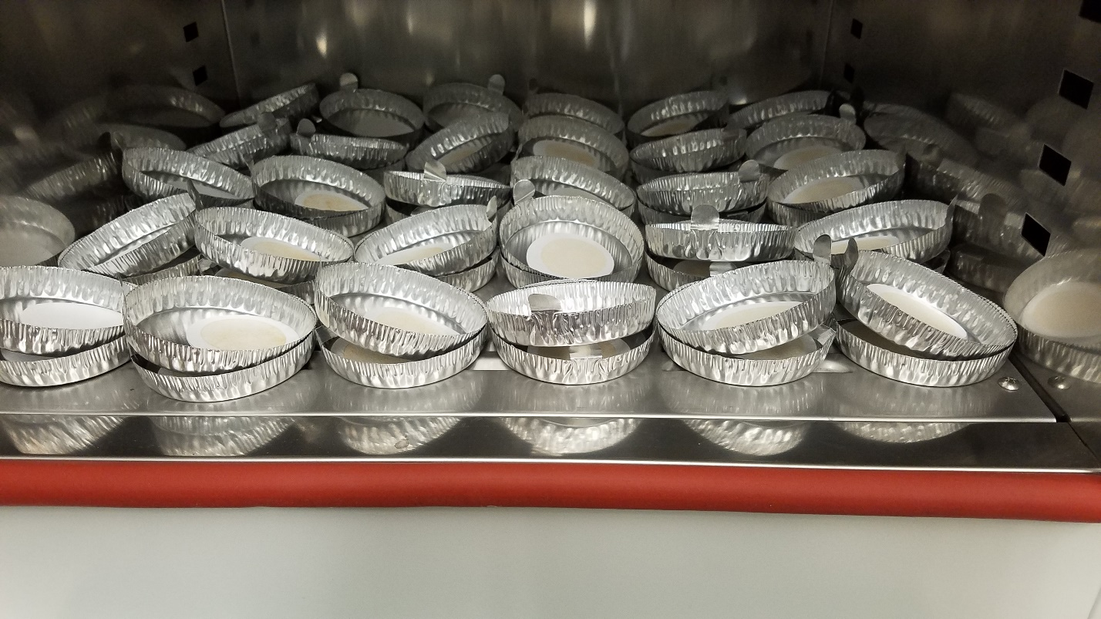
Filtering Protocol
Samples from peristaltic pumps were filtered through glass microfiber filters, dried, and weighed
Sediment mass/sample volume = mass concentration

Slide 19
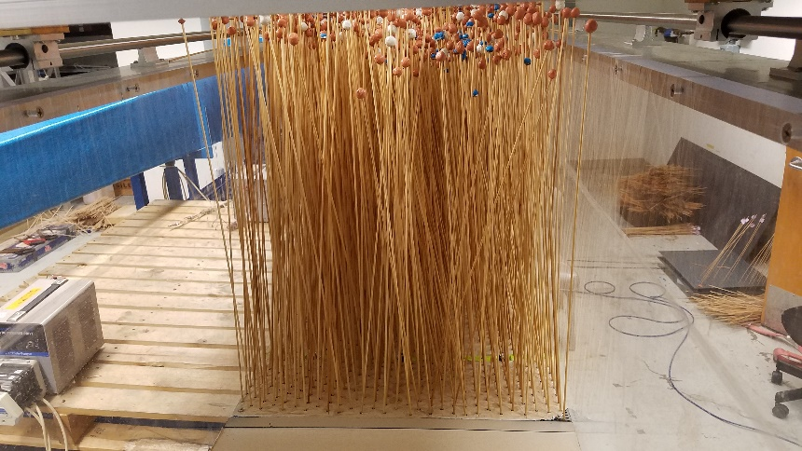
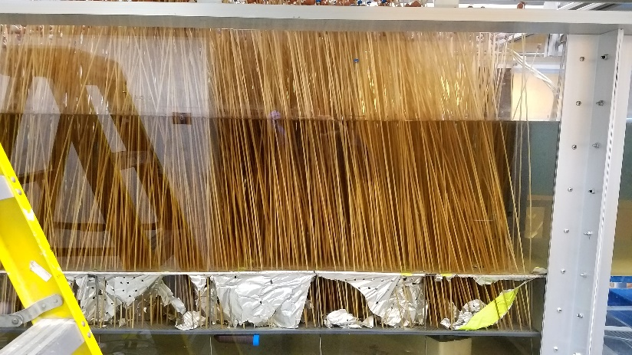
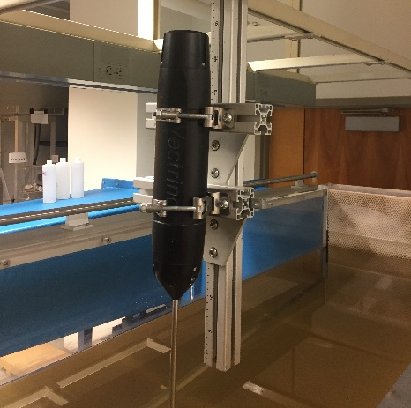
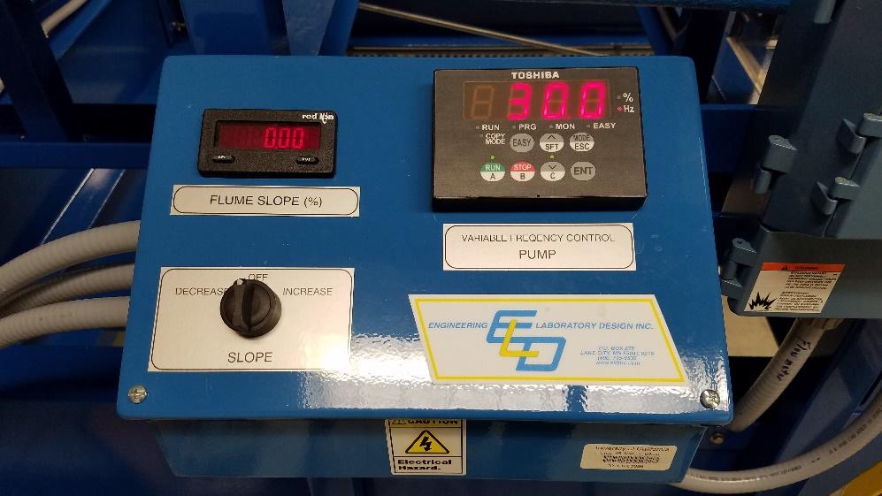
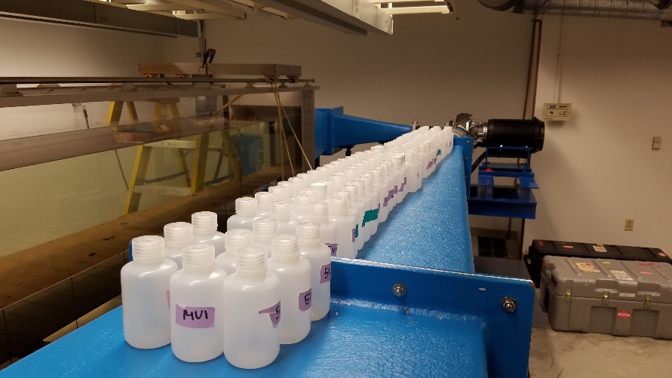
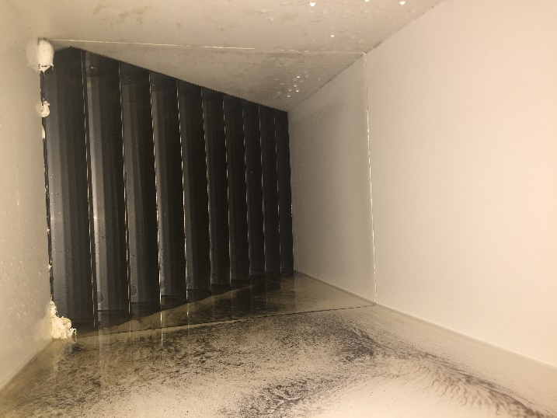
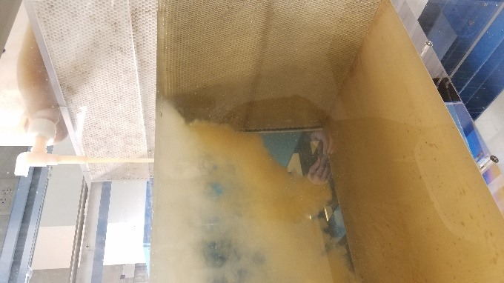
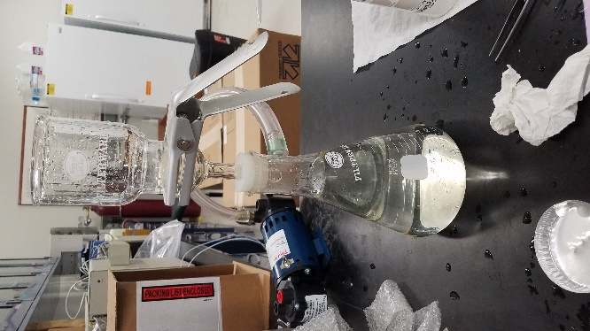
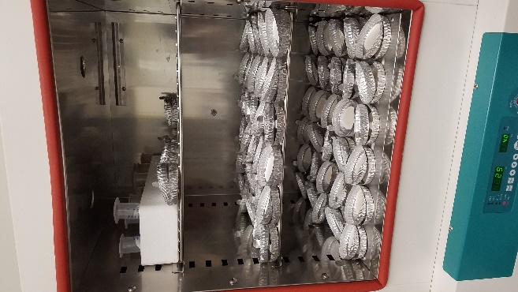
Experiment Protocol Summary
Install dowels
(if necessary)
2. Fill flume
3. Set up instruments,
sediment traps
4. Input settings,
turn on flume
5. Add sediment
6. Collect data
7. Clean flume (sometimes)
8. Filter, dry, and weigh

Slide 20


Slide 21
Results
Flume sediment transport description
Shields criterion
Treatment comparison
Particle capture rates
Effective capture efficiency
Predicted vs actual effective capture efficiency

Slide 22
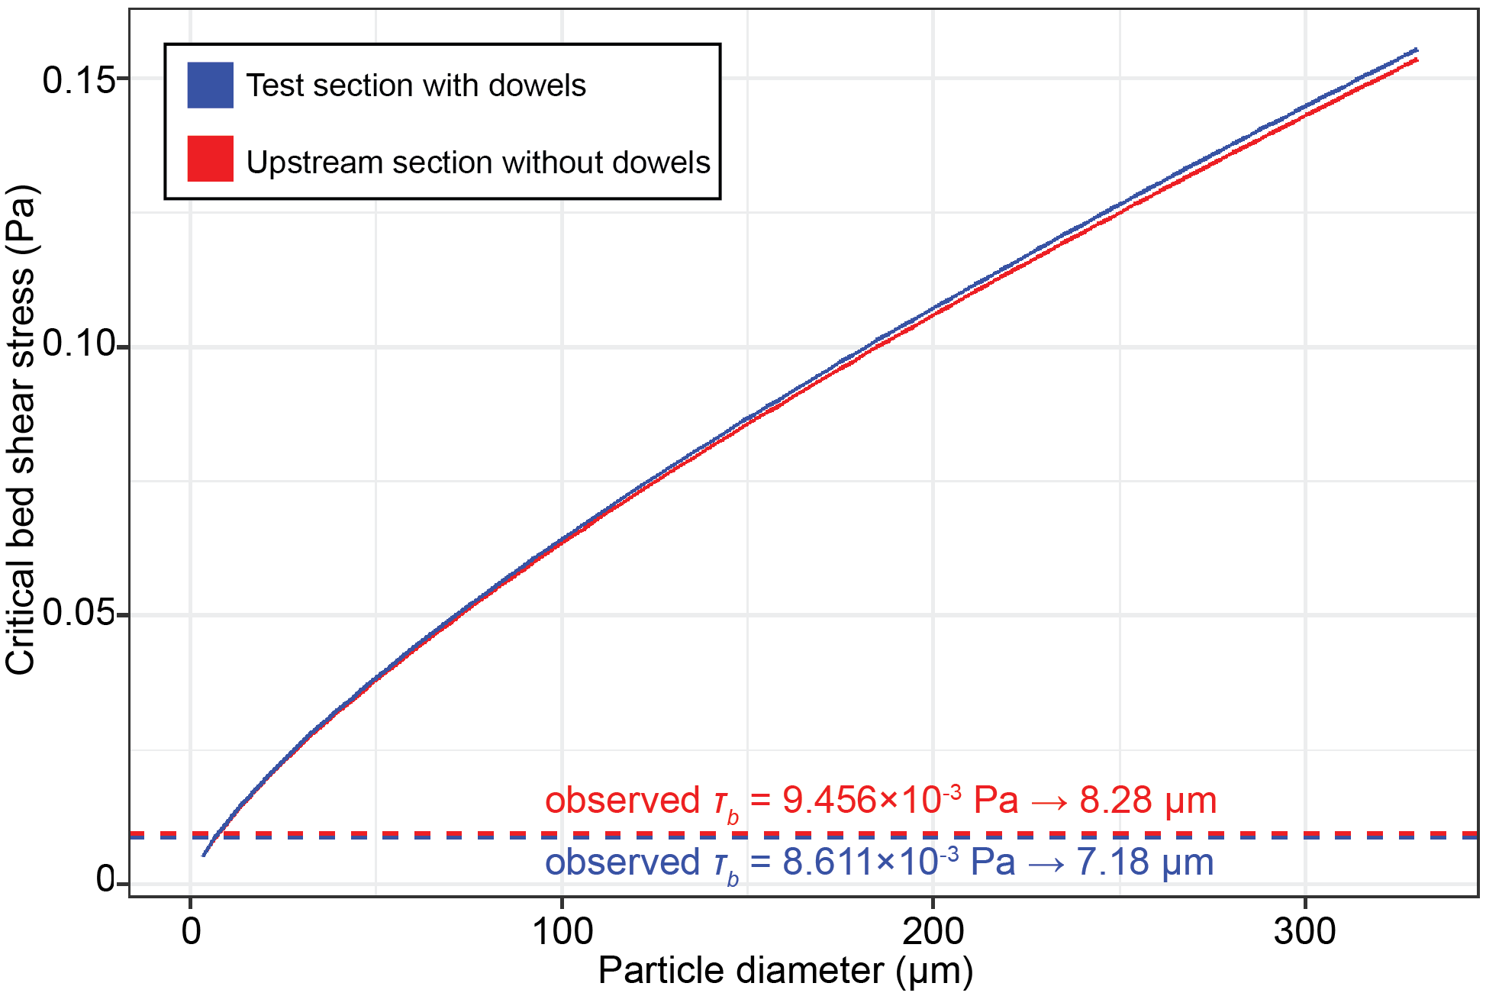
Sediment transport regime
Shields criterion for initial particle motion
Conclusion: particles travel in suspension, negligible bed load and resuspension
Supports application of background theory

Slide 23
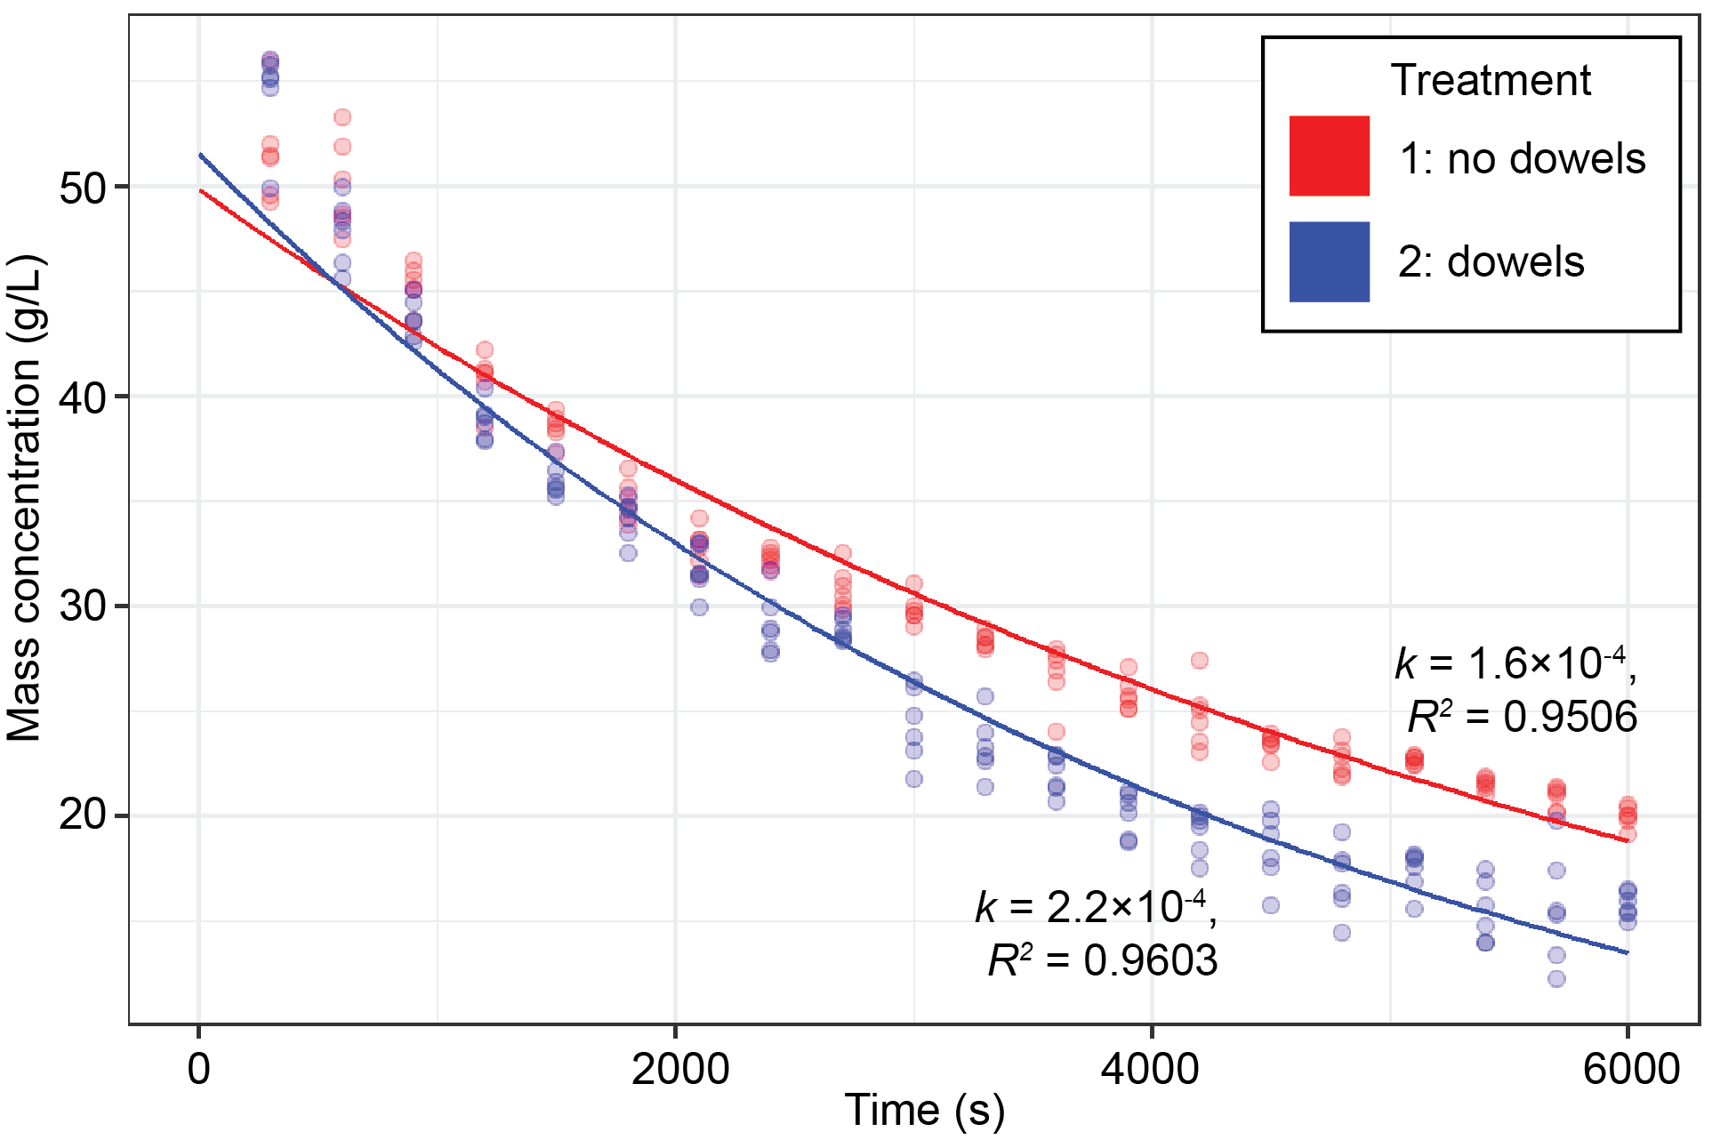
Treatment Comparison
For each experiment, model fitted to all peristaltic pump data points
Insignificant upstream/downstream contrast
Model:

Slide 24
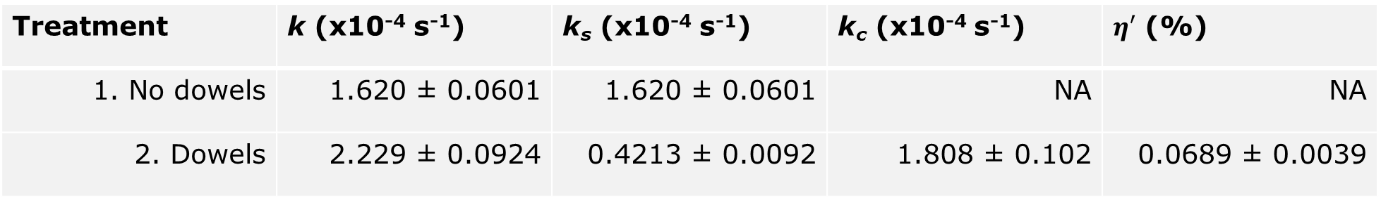
Treatment Comparison
Treatment | k (x10⁻⁴ s⁻¹) | k_{s} (x10⁻⁴ s⁻¹) | k_{c} (x10⁻⁴ s⁻¹) | $η′$ (%)
1. No dowels | 1.620 ± 0.0601 | 1.620 ± 0.0601 | NA | NA
2. Dowels | 2.229 ± 0.0924 | 0.4213 ± 0.0092 | 1.808 ± 0.102 | 0.0689 ± 0.0039
Compare: particle capture rates due to settling
Compare: particle capture rates due to settling versus capture on collectors
Order of magnitude differences

Slide 25
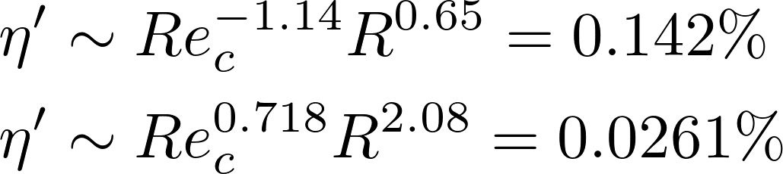
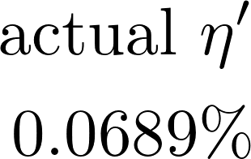
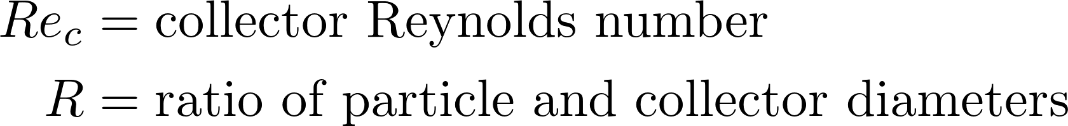
Predicted vs actual η’
Compare predicted effective capture efficiency by two existing power law models to calculated value
Palmer et al. [2004]:
Fauria et al. [2015]:
where

Slide 26
What do the results imply?
Particle capture mechanisms
Through comparison of experiments
Predictive models
Potential for improved accuracy in effective capture efficiency prediction?

Slide 27
Particle capture mechanisms
Two primary mechanisms:
Gravitational settling
Direct interception
Interaction of mechanisms with the presence of dowels due to flow instabilities
Treatment | k_{s} (x10⁻⁴ s⁻¹) | k_{c} (x10⁻⁴ s⁻¹)
1. No dowels | 1.620 ± 0.0601 | NA
2. Dowels | 0.4213 ± 0.0092 | 1.808 ± 0.102

Slide 28
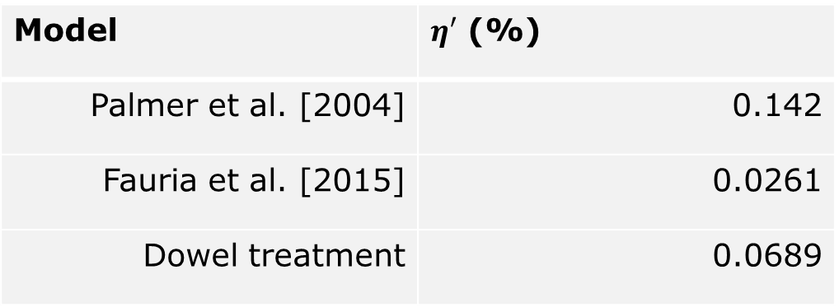
Predictive models
Comparable Re_{c} and R for experiments in this study, Palmer et al. [2004], and Fauria et al. [2015]
Different experimental conditions
Palmer: single cylindrical collector with smooth & rough greased surface
Fauria: array of emergent collectors with biofilm coating
Model | $η′$ (%)
Palmer et al. [2004] | 0.142
Fauria et al. [2015] | 0.0261
Dowel treatment | 0.0689

Slide 29
Predictive models
Alternative model
Add information on vegetation characteristics to kinematic and geometric parameters (Re_{c} & R)
Interference between many collectors with wake generation
Particles interact directly with stem surface

Slide 30
Conclusion
In the two experiments, dowel collectors augment overall particle capture rate
Interactions of dowels and particle settling
Possible additions to predictive models for effective capture efficiency (stem density and surface)
Better fit of experiment data to model with similar collector characteristics

Slide 31
Acknowledgements
Laurel Larsen for her research mentorship,
Jordan for his work on the flume and feedback,
Yayla, Candace, and Dani for assistance in flume experiments,
and everyone at the Environmental Systems Dynamics Laboratory for their support

Slide 32
References
Beckett, Ronald, and Ngoc P. Le. 1990. “The Role or Organic Matter and Ionic Composition in Determining the Surface Charge of Suspended Particles in Natural Waters.” Colloids and Surfaces 44 (January): 35–49. https://doi.org/10.1016/0166-6622(90)80185-7.
Biron, Pascale M., Colleen Robson, Michel F. Lapointe, and Susan J. Gaskin. 2004. “Comparing Different Methods of Bed Shear Stress Estimates in Simple and Complex Flow Fields.” Earth Surface Processes and Landforms 29 (11): 1403–15. https://doi.org/10.1002/esp.1111.
Britsch, Louis D., and Joseph B. Dunbar. 1993. “Land Loss Rates: Louisiana Coastal Plain.” Journal of Coastal Research 9 (2): 324–38.
Brownlie, William R. 1981. “Prediction of Flow Depth and Sediment Discharge in Open Channels.” Report. November 1981. http://resolver.caltech.edu/CaltechKHR:KH-R-43A.
Composition Materials. “200 Mesh Walnut Shell Flour (WF-5).” 2013. Composition Materials Co. July 25, 2013. https://compomat.com/200-mesh-walnut-shell-flour-wf-5.
Discflo. “About Classic – Discflo.” n.d. Accessed April 20, 2019. https://discflo.com/about-classic.
Droppo, I. G., G. G. Leppard, D. T. Flannigan, and S. N. Liss. 1997. “The Freshwater Floc: A Functional Relationship of Water and Organic and Inorganic Floc Constituents Affecting Suspended Sediment Properties.” In The Interactions Between Sediments and Water: Proceedings of the 7th International Symposium, Baveno, Italy 22–25 September 1996, edited by R. Douglas Evans, Joe Wisniewski, and Jan R. Wisniewski, 43–53. Dordrecht: Springer Netherlands. https://doi.org/10.1007/978-94-011-5552-6_5.
Fauria, Kristen E., Rachel E. Kerwin, Daniel Nover, and S. Geoffrey Schladow. 2015. “Suspended Particle Capture by Synthetic Vegetation in a Laboratory Flume.” Water Resources Research 51 (11): 9112–26. https://doi.org/10.1002/2014WR016481.
Fuchs, N. A. 1964. The Mechanics of Aerosols, edited by R. E. Daisley and M. Fuchs. New York: Pergamon.
García, Marcelo H. 2008. “Sediment Transport and Morphodynamics.” In Sedimentation Engineering: Processes, Measurements, Modeling, and Practice - ASCE Manuals and Reports on Engineering Practice (MOP) No. 110, edited by Marcelo H. García, 21-164. Reston: American Society of Civil Engineers. https://doi.org/10.1061/9780784408148.ch02.
Kadlec, Robert H. 1990. “Overland Flow in Wetlands: Vegetation Resistance.” Journal of Hydraulic Engineering 116 (5): 691–706. https://doi.org/10.1061/(ASCE)0733-9429(1990)116:5(691).
Nepf, Heidi M. 1999. “Drag, Turbulence, and Diffusion in Flow through Emergent Vegetation.” Water Resources Research 35 (2): 479–89. https://doi.org/10.1029/1998WR900069.
Nortek. 2019. “Velocimeter for Boundary Velocity Profile Measurements.” Text/html. Nortek. April 26, 2019. https://www.nortekgroup.com/products/vectrino-profiler.
Palmer, Molly R., Nepf Heidi M., Pettersson Thomas J. R., and Ackerman Josef D. 2004. “Observations of Particle Capture on a Cylindrical Collector: Implications for Particle Accumulation and Removal in Aquatic Systems.” Limnology and Oceanography 49 (1): 76–85. https://doi.org/10.4319/lo.2004.49.1.0076.
Purich, Ariaan. 2006. “The Capture of Suspended Particles by Aquatic Vegetation.” PhD diss., School of Environmental Systems Engineering, University of Western Australia. http://www.westerlycentre.uwa.edu.au/__data/assets/pdf_file/0009/1637505/Purich_2007.pdf.
Rubenstein, Daniel I., and M. A. R. Koehl. 1977. “The Mechanisms of Filter Feeding: Some Theoretical Considerations.” The American Naturalist 111 (981): 981–94. https://doi.org/10.1086/283227.
Spielman, Lloyd A. 1977. “Particle Capture from Low-Speed Laminar Flows.” Annual Review of Fluid Mechanics 9 (1): 297–319. https://doi.org/10.1146/annurev.fl.09.010177.001501.
Sutherland, Bruce R., Kai J. Barrett, and Murray K. Gingras. 2015. “Clay Settling in Fresh and Salt Water.” Environmental Fluid Mechanics 15 (1): 147–60. https://doi.org/10.1007/s10652-014-9365-0.
Syvitski, James P. M., Albert J. Kettner, Irina Overeem, Eric W. H. Hutton, Mark T. Hannon, G. Robert Brakenridge, John Day, et al. 2009. “Sinking Deltas Due to Human Activities.” Nature Geoscience 2 (10): 681–86. https://doi.org/10.1038/ngeo629.
Wu, Lei, Bin Gao, and Rafael Muñoz-Carpena. 2011. “Experimental Analysis of Colloid Capture by a Cylindrical Collector in Laminar Overland Flow.” Environmental Science & Technology 45 (18): 7777–84. https://doi.org/10.1021/es201578n.

